Slide 1
Encoder-Decoder Seq to Seq Models
https://medium.com/nerd-for-tech/nlp-theory-and-code-encoder-decoder-models-part-11-30-e686bcb61dc7
https://towardsdatascience.com/word-level-english-to-marathi-neural-machine-translation-using-seq2seq-encoder-decoder-lstm-model-1a913f2dc4a7

Slide 2
(11) Encoder-Decoder Sequence to Sequence(Seq2Seq) model explained by Abhilash | RNN | LSTM | Transformer – YouTube
(11) Deep Learning(CS7015): Lec 15.1 Introduction to Encoder Decoder Models - YouTube

Slide 3
Sequence to sequence model
Recurrent Neural Networks (or more precisely LSTM/GRU) have been found to be very effective in solving complex sequence related problems given a large amount of data. They have real time applications in speech recognition, Natural Language Processing (NLP) problems, time series forecasting, etc.
Sequence to Sequence (often abbreviated to seq2seq) models are a special class of Recurrent Neural Network architectures typically used (but not restricted) to solve complex Language related problems like Machine Translation, Question Answering, creating Chat-bots, Text Summarization, etc.

Slide 4
Use Cases of the Sequence to Sequence Model
For instance, seq2seq model powers applications like Google Translate, voice-enabled devices and online chatbots.
Machine translation
Speech recognition
Video captioning
This model can be used as a solution to any sequence-based problem, especially ones where the inputs and outputs have different sizes and categories.

Slide 5
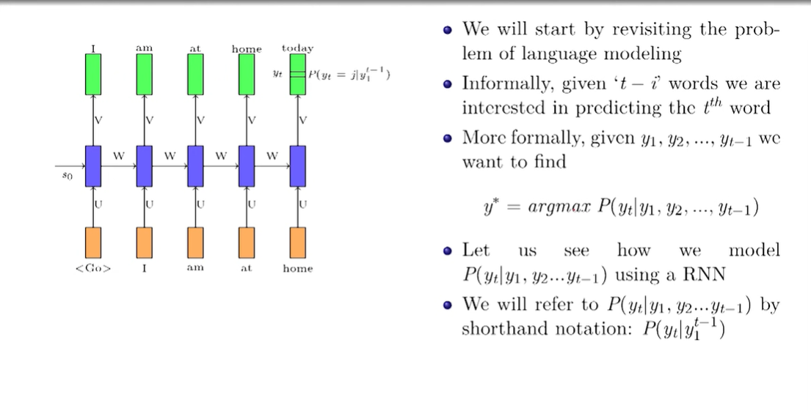

Slide 6
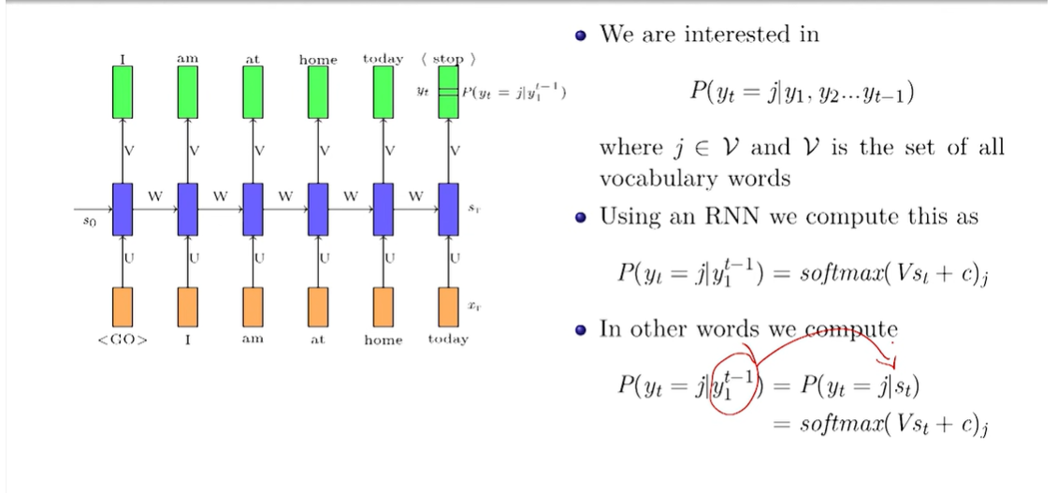

Slide 8
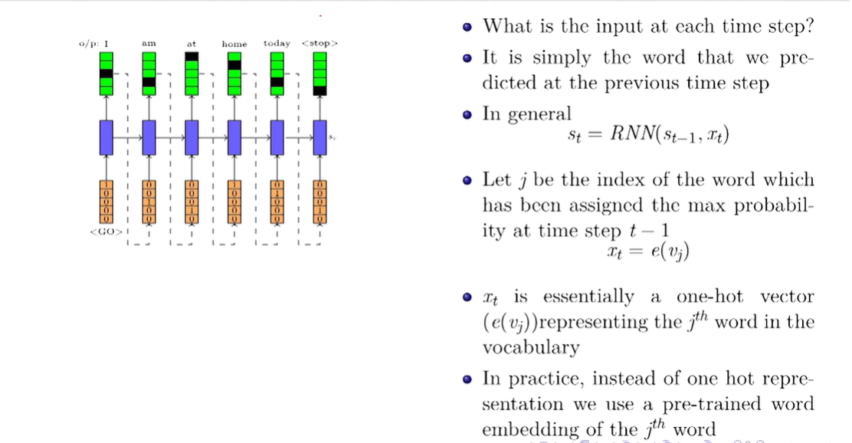

Slide 9
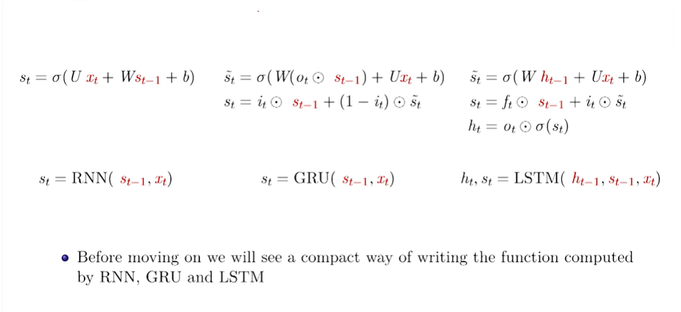

Slide 11
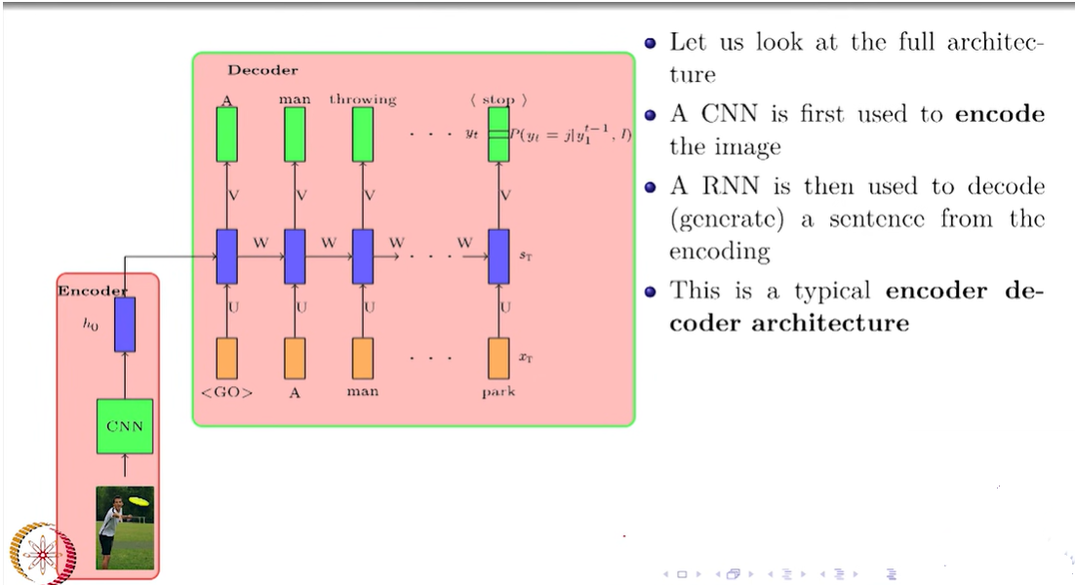

Slide 12
A sequence to sequence model aims to map a fixed-length input with a fixed-length output where the length of the input and output may differ.
For example, translating “What are you doing today?” from English to Chinese has input of 5 words and output of 7 symbols (今天你在做什麼？). Clearly, we can’t use a regular LSTM network to map each word from the English sentence to the Chinese sentence.

Slide 13
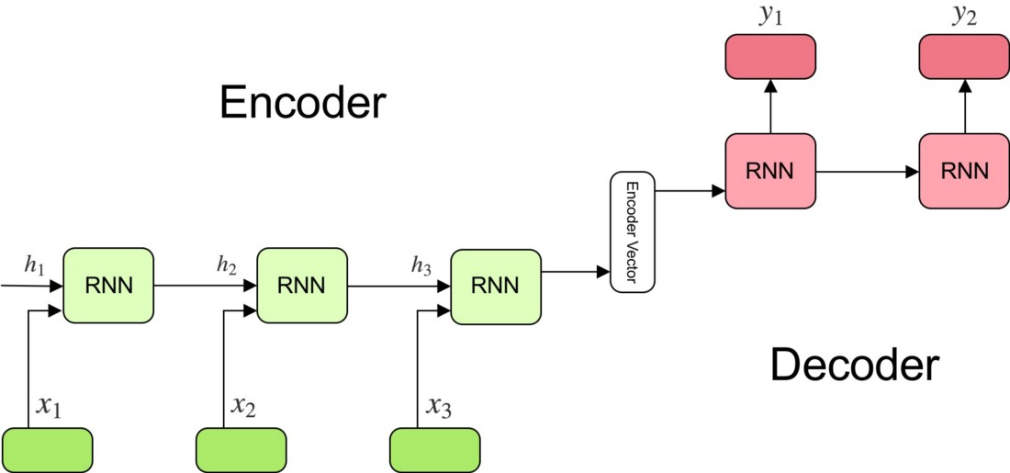
How the Sequence to Sequence Model works?

Slide 14
The model consists of 3 parts: encoder, intermediate (encoder) vector and decoder.

Slide 15

Encoder
A stack of several recurrent units (LSTM or GRU cells for better performance) where each accepts a single element of the input sequence, collects information for that element and propagates it forward.
In question-answering problem, the input sequence is a collection of all words from the question. Each word is represented as x_i where i is the order of that word.
The hidden states h_i are computed using the formula:
This simple formula represents the result of an ordinary recurrent neural network. As you can see, we just apply the appropriate weights to the previous hidden state h_(t-1) and the input vector x_t.

Slide 16
Encoder Vector
This is the final hidden state produced from the encoder part of the model. It is calculated using the formula above.
This vector aims to encapsulate the information for all input elements in order to help the decoder make accurate predictions.
It acts as the initial hidden state of the decoder part of the model.

Slide 17

Decoder
A stack of several recurrent units where each predicts an output y_t at a time step t.
Each recurrent unit accepts a hidden state from the previous unit and produces and output as well as its own hidden state.
In the question-answering problem, the output sequence is a collection of all words from the answer. Each word is represented as y_i where i is the order of that word.
Any hidden state h_i is computed using the formula:

Slide 18

As you can see, we are just using the previous hidden state to compute the next one.
The output y_t at time step t is computed using the formula:
We calculate the outputs using the hidden state at the current time step together with the respective weight W(S). Softmax is used to create a probability vector which will help us determine the final output (e.g. word in the question-answering problem).
The power of this model lies in the fact that it can map sequences of different lengths to each other. As you can see the inputs and outputs are not correlated and their lengths can differ. This opens a whole new range of problems which can now be solved using such architecture.

Slide 19
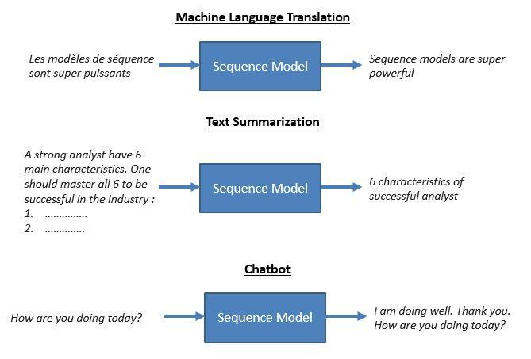
Machine Language Translation

Slide 20
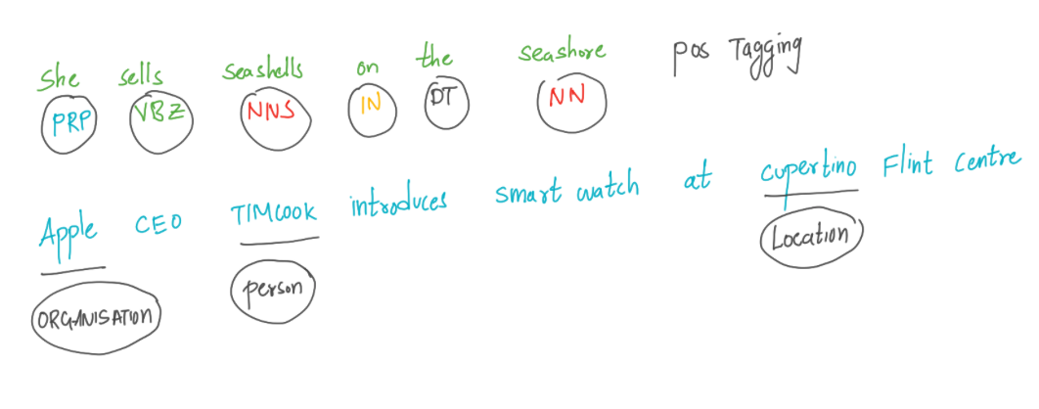
Machine Language Translation
In tasks like machine translation, we must map from a sequence of input words to a sequence of output words. The reader must note that this is not similar to “sequence labelling”, where that task it to map each word in the sequence to a predefined classes, like part-of-speech or named entity task.
In above two examples, the models are tasked to map each word in the sequence to a tag/class.

Slide 21
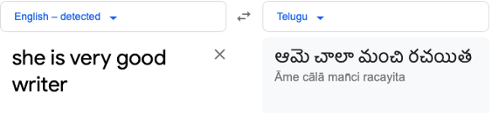

Machine Language Translation
In tasks like machine translation: the length of inputs sequence need to not necessarily length of output sequence.
As you can see in the google translation example, the input length is “5” and output length is “4”.
Since we are mapping an input sequence to an output sequence, thus comes the name sequence to sequence models.
Not only the length of input and output sequence differs but the order of words also differ.
This is very complex task in NLP and Encoder- decoder networks are very successful at handling these sorts of complicated tasks of sequence to sequence mapping.

Slide 22
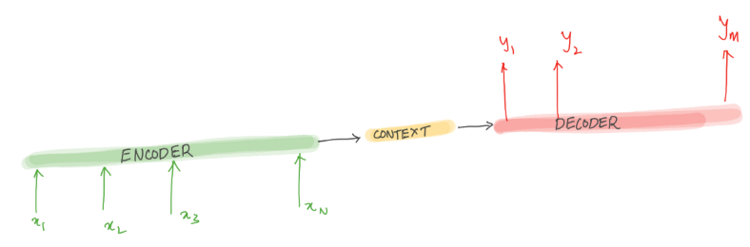
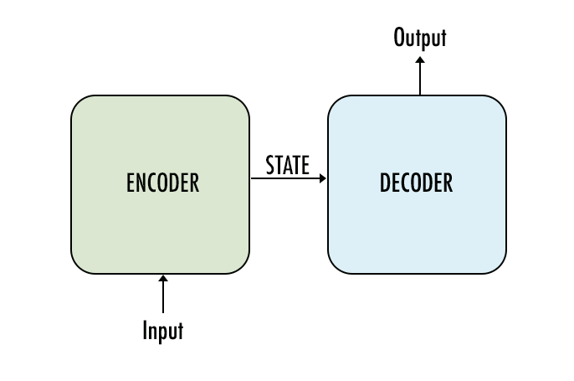
The Encoder-Decoder Network
This network have been applied to very wide range of applications including machine translation, text summarisation, questioning answering and dialogue. Let’s try to understand the idea underlying the encoder-decoder networks.
The encoder takes the input sequence and creates a contextual representation (which is also called context) of it and the decoder takes this contextual representation as input and generates output sequence.

Slide 23
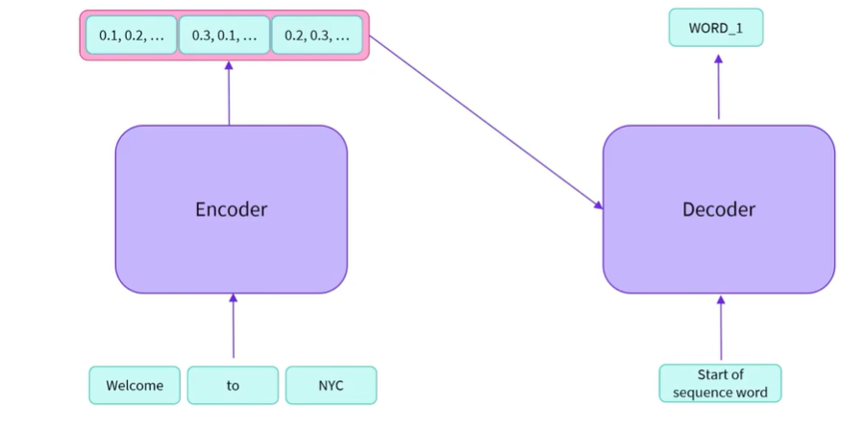

Slide 24
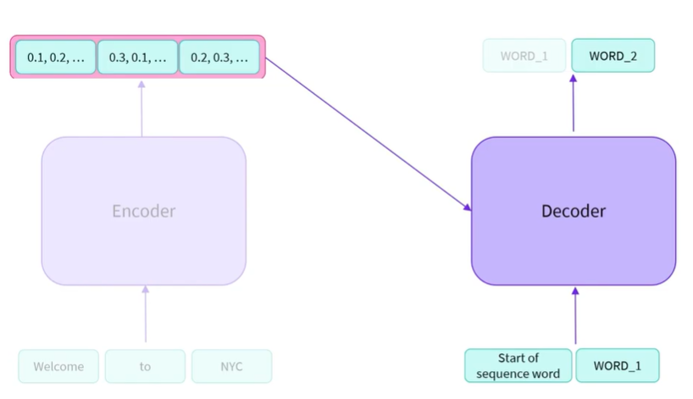

Slide 25
The Encoder-Decoder Network-System Flow
a. Both encoder and the decoder are typically LSTM models
b. Encoder reads the input sequence and summarizes the information in something called as the internal state vectors (in case of LSTM these are called as the hidden state and cell state vectors). We discard the outputs of the encoder and only preserve the internal states.
c. Decoder is an LSTM whose initial states are initialized to the final states of the Encoder LSTM. Using these initial states, decoder starts generating the output sequence.
d. The decoder behaves a bit differently during the training and inference procedure. During the training, we use a technique call teacher forcing which helps to train the decoder faster. During inference, the input to the decoder at each time step is the output from the previous time step.
e. Intuitively, the encoder summarizes the input sequence into state vectors (sometimes also called as Thought vectors), which are then fed to the decoder which starts generating the output sequence given the Thought vectors. The decoder is just a language model conditioned on the initial states.

Slide 26
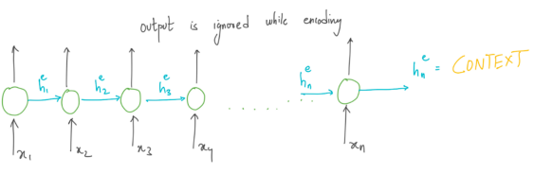
Encoder:
Encoder takes the input sequence and generated a context which is the essence of the input to the decoder
The entire purpose of the encoder is to generate a contextual representation/ context for the input sequence.
Using RNN as encoder, the final hidden state of the RNN sequence chain can be used a proxy for context.
This is the most critical concept which forms the basis for encoder-decoder models.
We will use the subscripts e and d for the hidden state of the encoder and decoder. Outputs of encoder is ignored, as the goal is to generate final hidden state or context for decoder.

Slide 27
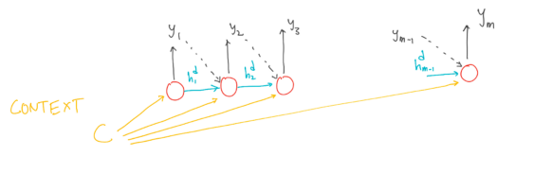
Decoder
Decoder takes the context as input and generates a sequence of output.
When we employ RNN as decoder, the context is the final hidden state of the RNN encoder.
The first decoder RNN cell takes “CONTEXT” as its prior hidden state.
The decoder then generated the output until the end-of-sequence marker is generated.
Each cell in RNN decoder takes input auto regressively, i.e, The decoder uses its own estimated output at time t as the input for the next time step xt+1.
One important drawback if the context is made available only for first decoder RNN cell is the the context wanes as more and more output sequence is generated.
To overcome this drawback the “CONTEXT” can be made available at each decoding RNN time step. There is a little deviation from the vanilla-RNN. Let’s look at the updated the equations for decoder RNN.

Slide 28
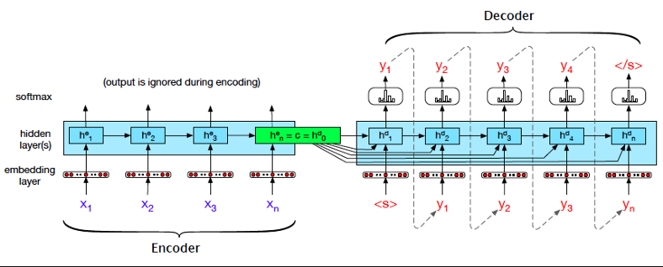
Complete Encoder and Decoder network

Slide 29
Training the Encoder — Decoder Model
The training data consists of sets of input sentences and their respective output sequences .
We use cross entropy loss in the decoder.
Encoder-decoder architectures are trained end-to-end, just as with the RNN language models.
The loss is calculated and then back-propagated to update weights using the gradient descent optimisation.
The total loss is calculated by averaging the cross-entropy loss per target word.

Slide 30
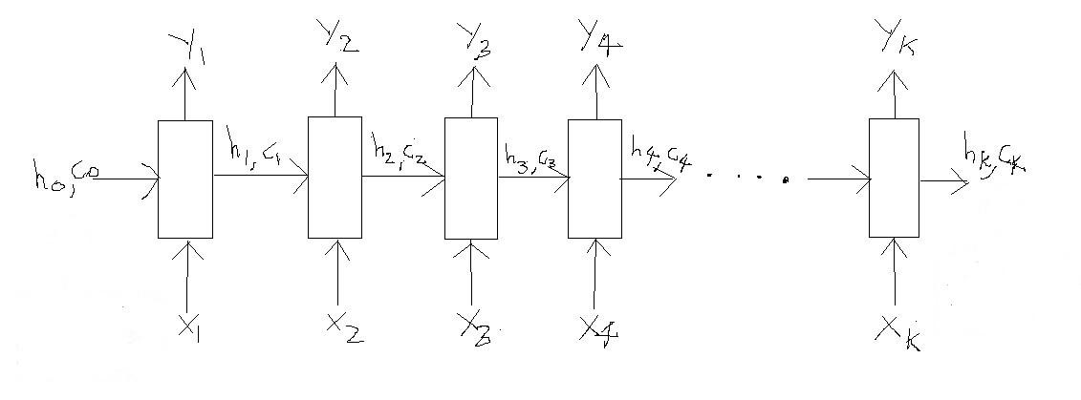
Word Level English to Marathi Neural Machine Translation using Encoder-Decoder Model

Slide 31
Word Level English to Marathi Neural Machine Translation using Encoder-Decoder Model
The LSTM reads the data one sequence after the other. Thus if the input is a sequence of length ‘k’, we say that LSTM reads it in ‘k’ time steps (think of this as a for loop with ‘k’ iterations).
Referring to the above diagram, below are the 3 main components of an LSTM:
a. Xi => Input sequence at time step i
b. hi and ci => LSTM maintains two states (‘h’ for hidden state and ‘c’ for cell state) at each time step. Combined together these are internal state of the LSTM at time step i.
c. Yi => Output sequence at time step i
Important: Technically all of these components (Xi, hi, ci and Yi) are actually vectors of floating point numbers (explained below)
Let’s try to map all of these in the context of our problem. Recall that our problem is to translate an English sentence to its Marathi equivalent. For the purpose of this blog we will consider the below example. Say, we have the following sentence
Input sentence (English)=> “Rahul is a good boy”
Output sentence (Marathi) => “राहुल चांगला मुलगा आहे”
For now just focus on the input i.e. the English sentence

Slide 32
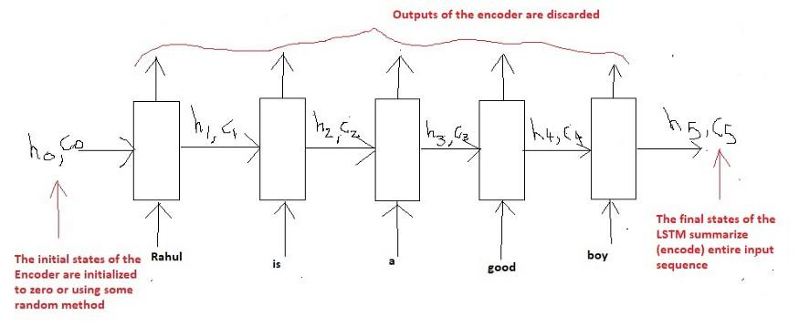
Explanation for Xi:
Now a sentence can be seen as a sequence of either words or characters. For example in case of words, the above English sentence can be thought of as a sequence of 5 words (‘Rahul’, ‘is’, ‘a’, ‘good’, ‘boy’). And in case of characters, it can be thought of as a sequence of 19 characters (‘R’, ‘a’, ‘h’, ‘u’, ‘l’, ‘ ‘, ……, ‘y’).
We will break the sentence by words as this scheme is more common in real world applications. Hence the name ‘Word Level NMT’.
So, referring to the diagram above, we have the following input:
X1 = ‘Rahul’, X2 = ‘is’, X3 = ‘a’, X4 = ‘good, X5 = ‘boy’.
But one question that we must answer is how to represent each Xi (each word) as a vector?
There are various word embedding techniques which map (embed) a word into a fixed length vector
However, we will use the built-in Embedding Layer of the Keras API to map each word into a fixed length vector.

Slide 33
Explanation for hi and ci:
The next question is what is the role of the internal states (hi and ci) at each time step?
For example:
h3, c3 =>These two vectors will remember that the network has read “Rahul is a” till now. Basically its the summary of information till time step 3 which is stored in the vectors h3 and c3 (thus called the states at time step 3).
Similarly, we can thus say that h5, c5 will contain the summary of the entire input sentence, since this is where the sentence ends (at time step 5).
These states coming out of the last time step are also called as the “Thought vectors” as they summarize the entire sequence in a vector form.
Then what about h0,c0? These vectors are typically initialized to zero as the model has not yet started to read the input.
Note: The size of both of these vectors is equal to number of units (neurons) used in the LSTM cell.

Slide 34
Explanation for Yi:
Finally, what about Yi at each time step? These are the output (predictions) of the LSTM model at each time step.
But what type of a vector is Yi? More specifically in case of word level language models each Yi is actually a probability distribution over the entire vocabulary which is generated by using a softmax activation.
Thus each Yi is a vector of size “vocab_size” representing a probability distribution.
Depending on the context of the problem they might sometimes be used or sometimes be discarded.
In our case we have nothing to output unless we have read the entire English sentence. Because we will start generating the output sequence (equivalent Marathi sentence) once we have read the entire English sentence. Thus we will discard the Yi of the Encoder for our problem.

Slide 35
Summary of the encoder:
We will read the input sequence (English sentence) word by word and preserve the internal states of the LSTM network generated after the last time step hk, ck (assuming the sentence has ‘k’ words).
These vectors (states hk and ck) are called as the encoding of the input sequence, as they encode (summarize) the entire input in a vector form.
Since we will start generating the output once we have read the entire sequence, outputs (Yi) of the Encoder at each time step are discarded.
Moreover you must also understand what type of vectors are Xi, hi, ci and Yi. What are their sizes (shapes) and what do they represent.
If you have any confusion understanding this part, then you need to first strengthen your understanding of LSTM and language models.

Slide 36
Decoder LSTM — Training Mode
Unlike the Encoder LSTM which has the same role to play in both the training phase as well as in the inference phase, the Decoder LSTM has a slightly different role to play in both of these phases.
Recall that given the input sentence “Rahul is a good boy”, the goal of the training process is to train (teach) the decoder to output “राहुल चांगला मुलगा आहे”. Just as the Encoder scanned the input sequence word by word, similarly the Decoder will generate the output sequence word by word.
For some technical reasons (explained later) we will add two tokens in the output sequence as follows:
Output sequence => “START_ राहुल चांगला मुलगा आहे _END”

Slide 38
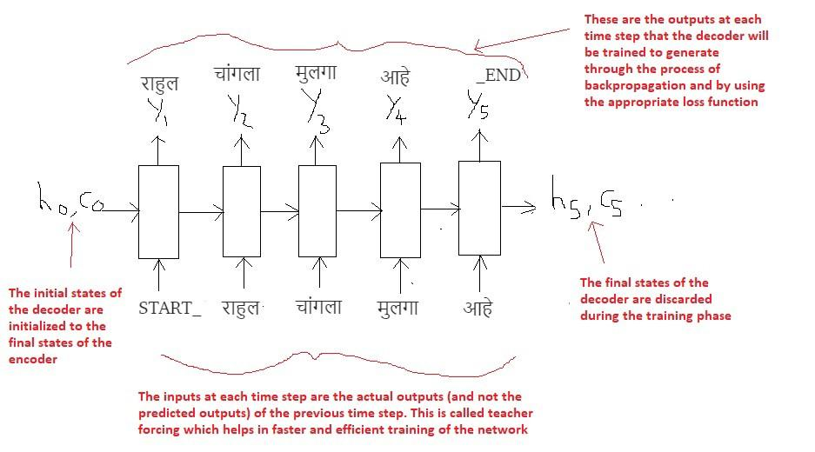
Decoder Training Phase

Slide 39
Decoder Training Phase
The most important point is that the initial states (h0, c0) of the decoder are set to the final states of the encoder.
This intuitively means that the decoder is trained to start generating the output sequence depending on the information encoded by the encoder.
Obviously the translated Marathi sentence must depend on the given English sentence.
In the first time step we provide the START_ token so that the decoder starts generating the next token (the actual first word of Marathi sentence).
And after the last word in the Marathi sentence, we make the decoder learn to predict the _END token.
This will be used as the stopping condition during the inference procedure, basically it will denote the end of the translated sentence and we will stop the inference loop

Slide 40
Teacher Forcing
We use a technique called “Teacher Forcing” wherein the input at each time step is given as the actual output (and not the predicted output) from the previous time step.
This helps in more faster and efficient training of the network.
To understand more about teacher forcing, refer this- https://machinelearningmastery.com/teacher-forcing-for-recurrent-neural-networks/
Finally the loss is calculated on the predicted outputs from each time step and the errors are back propagated through time in order to update the parameters of the network.
Training the network over longer period with sufficiently large amount of data results in pretty good predictions

Slide 41
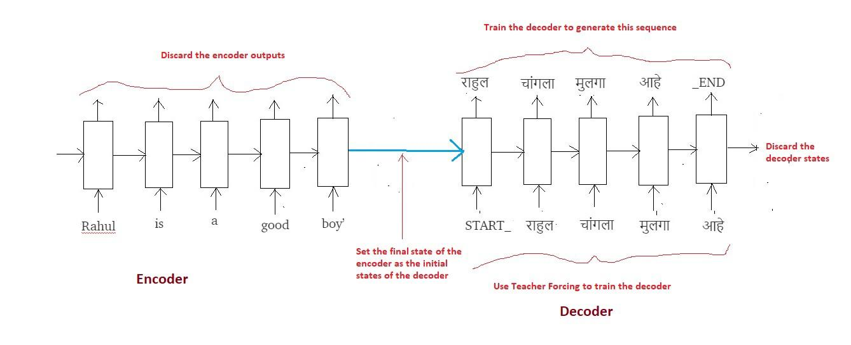
The entire training process (Encoder + Decoder) can be summarized in the below diagram:

Slide 42
Decoder LSTM — Inference Mode
Let’s now try to understand the setup required for inference.
As already stated the Encoder LSTM plays the same role of reading the input sequence (English sentence) and generating the thought vectors (hk, ck).
However, the decoder now has to predict the entire output sequence (Marathi sentence) given these thought vectors.
Let’s try to visually understand by taking the same example.
Input sequence => “Rahul is a good boy”
(Expected) Output Sequence => “राहुल चांगला मुलगा आहे”

Slide 43
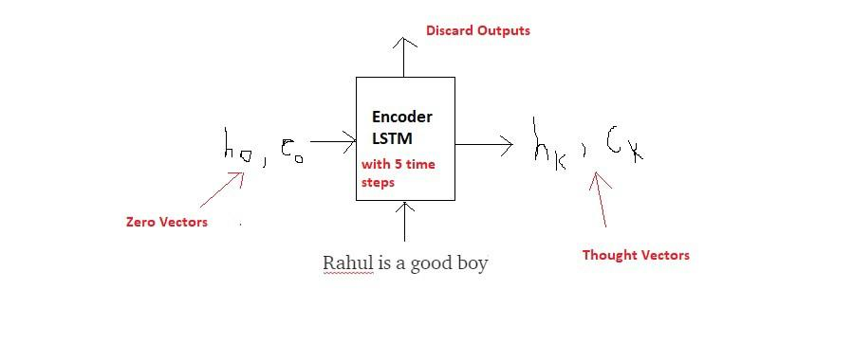
Step 1: Encode the input sequence into the Thought Vectors:
Encode the input sequence into thought vectors

Slide 44
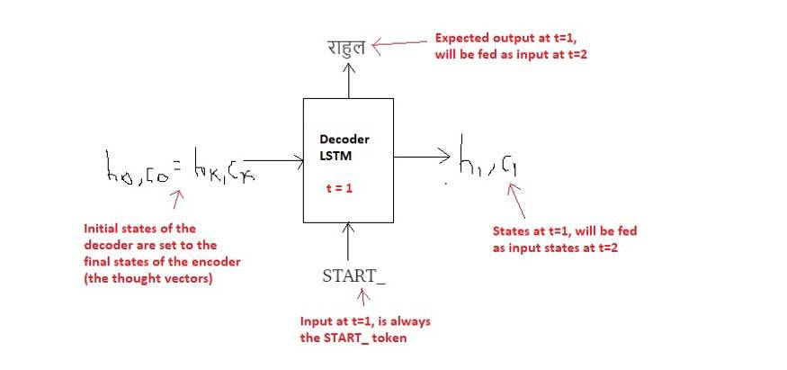
Step 2: Start generating the output sequence in a loop, word by word:

Slide 45
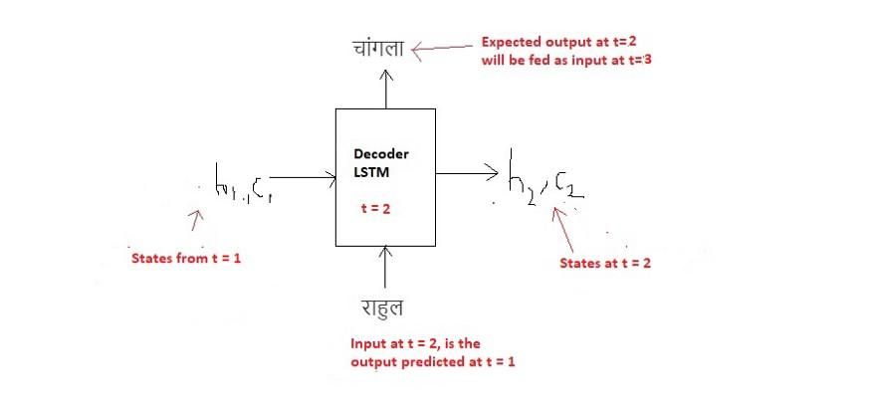
t=1

Slide 46
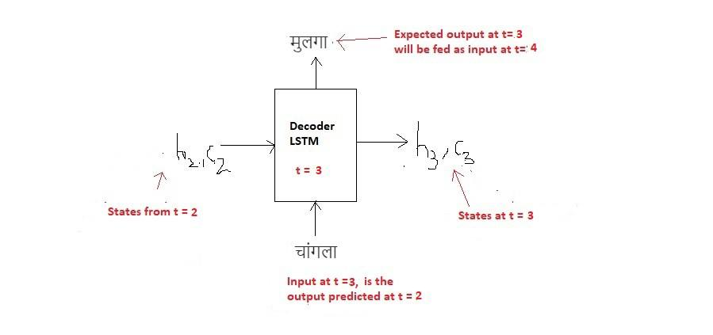
T=2

Slide 47
T=3

Slide 48

T=4

Slide 49
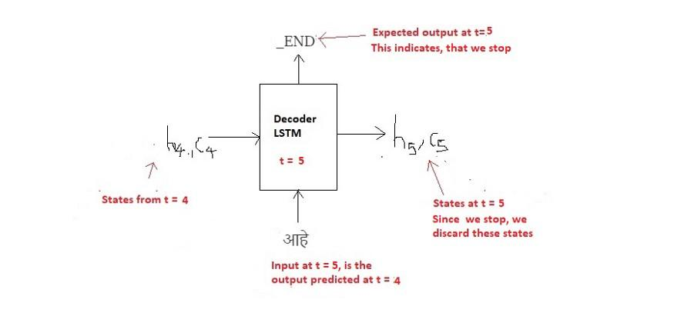
T=5

Slide 50
Inference Algorithm
a. During inference, we generate one word at a time. Thus the Decoder LSTM is called in a loop, every time processing only one time step.
b. The initial states of the decoder are set to the final states of the encoder.
c. The initial input to the decoder is always the START_ token.
d. At each time step, we preserve the states of the decoder and set them as initial states for the next time step.
e. At each time step, the predicted output is fed as input in the next time step.
f. We break the loop when the decoder predicts the END_ token.

Slide 51
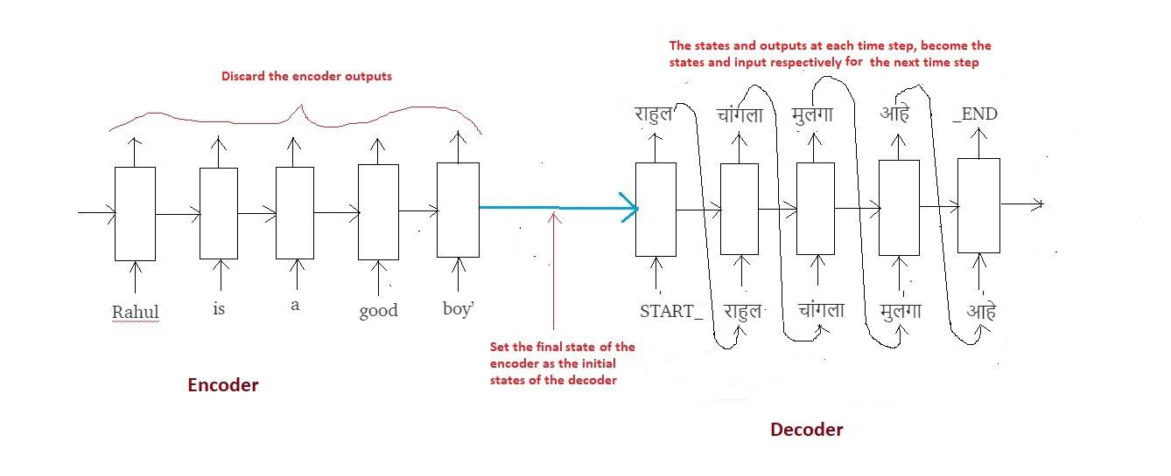
Encoder –Decoder Model

Slide 52
(12) Deep Learning - Course Introduction - YouTube

